Slide 1
CBD Calla panel
Automatic assembly line
--- Stick T-side heat sink Machine
Jan 23, 2026

Slide 2






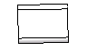
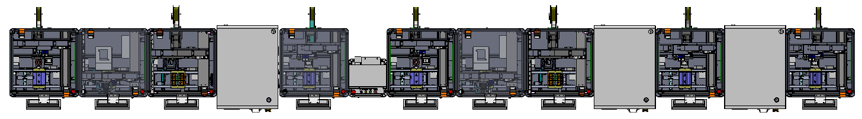

CBD Calla PCBA Assembly Line（New）
Line flow
unit：mm
900
900
800
840
900
600
900
900
800
840
900
840
900
Item | 1 | 2 | 3 | 4 | 5 | 6 | 7 | 8 | 9 | 4 | 11 | 12 | 13
Equipment | Stick B-side EMI Machine | Point B-side heat dissipation paste Machine | Stick B-side heat sink Machine（Robot） | Pressing machine | Stick B-side foam Machine*2 | Flip Over Machine | Stick T-side EMI Machine | Point T-side heat dissipation paste Machine | Stick T-side heat sink Machine（Robot） | Pressing machine | Stick FSS Machine | Pressing FSS machine | Stick T-side foam Machine*2
New /Old | old | old | old | Gs | old | Gs | old | old | old | Gs | new | Gs | old
CT(S) | 6 | 6 | 6 | 4 | 6 | 6 | 6 | 6 | 6 | 4 | 6 | 4 | 6
Feeding method | reel | Plastic bucket | reel | / | reel | reel | / | Plastic bucket | reel | / | reel | / | reel
Automation Assembly Line UPH ：500PCS/H
Automation Assembly Line Dimension ： L 11020mm * W 1500mm * H 1620mm (For reference, according to the actual)
Auto machine(new)
Auto machine(old)
Auto machine（Guest supply）

Slide 3


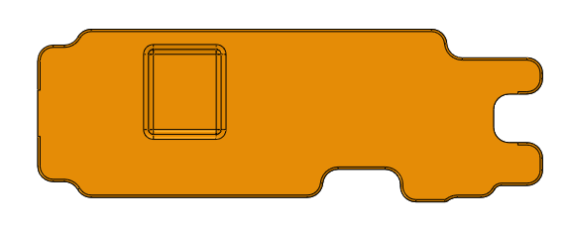


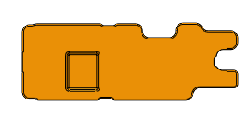

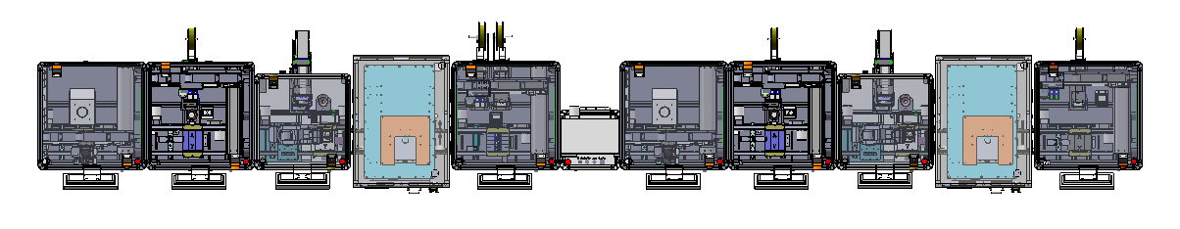
CBD Cony PCBA Assembly Line（Old）
Line flow
unit：mm
900
900
800
840
900
600
900
900
800
840
900
Item | 1 | 2 | 3 | 4 | 5 | 7 | 8 | 9 | 10 | 11 | 12
Equipment | Point B-side heat dissipation paste Machine | Stick B-side EMI Machine | Stick B-side heat sink Machine | Pressing machine | Stick B-side foam Machine*2 | Flip Over Machine | Point T-side heat dissipation paste Machine | Stick T-side EMI Machine | Stick T-side heat sink Machine | Pressing machine | Stick T-side foam Machine*1
New /Old | old | old | old | new | old | Gs | old | old | old | new | old
CT(S) | 4 | 5 | 6 | 3 | 6 |  | 6 | 5 | 6 | 3 | 6
Feeding method | Plastic bucket | reel | reel | / | reel | / | Plastic bucket | reel | reel | / | reel
Automation Assembly Line UPH ：500PCS/H
Automation Assembly Line Dimension ： L 9300mm * W 1500mm * H 1620mm (For reference, according to the actual)
Auto machine(new)
Auto machine(old)
Auto machine（Guest supply）

Slide 4
Contents
unit：mm
Item | Description | DRI
1 | Historical Versions | Wang hao
2 | Machine performance design | Wang hao
3 | Product Change | Wang hao
4 | Equipment Layout | Wang hao
5 | The key components | Wang hao
6 | Key Fixture Design | Wang hao
7 | Action flow design | Wang hao
8 | Timing diagram | Wang hao
3

Slide 5
1. Historical Versions
unit：mm
Version | Description | Date | DRI | Remark
V01 | Initial design version | 2026/01/23 | Wang hao
4

Slide 6
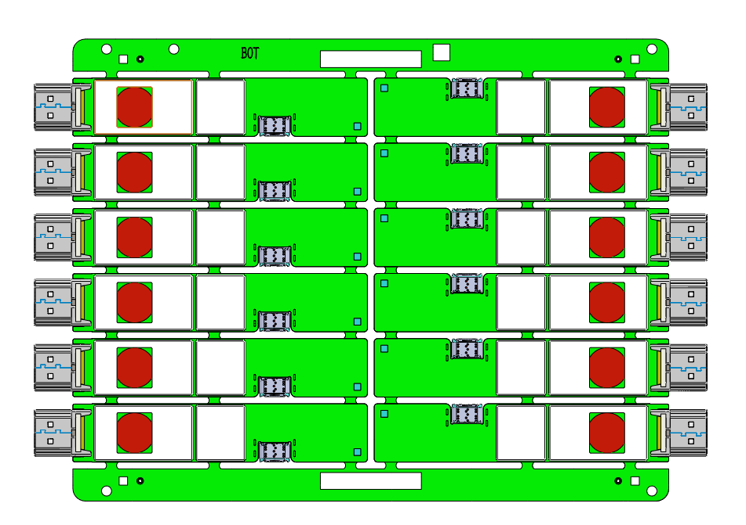
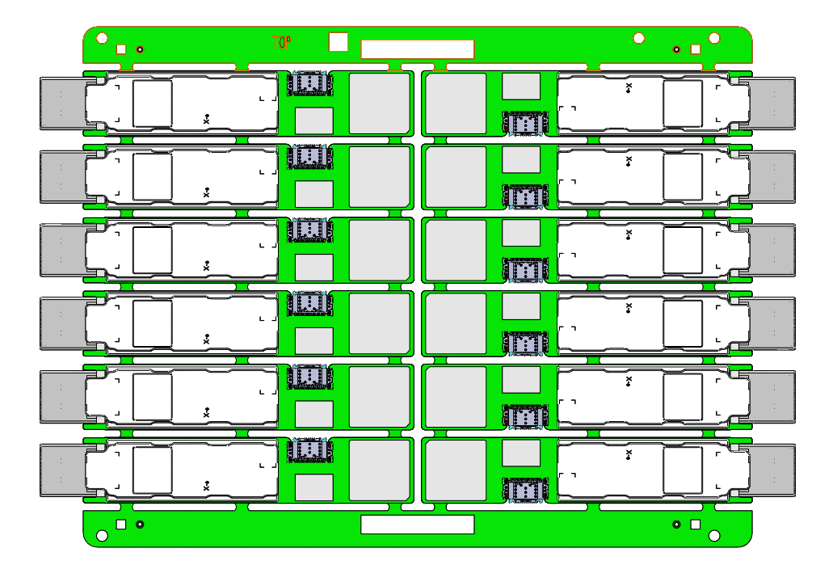
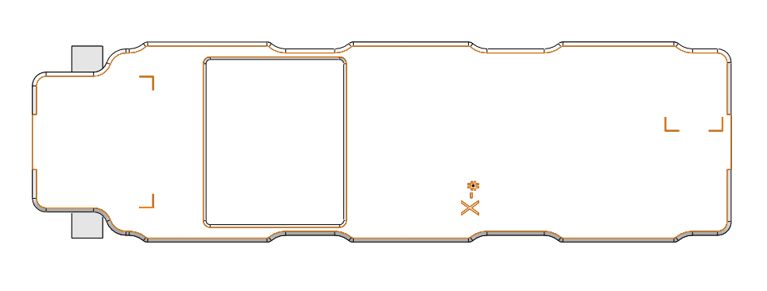
2. Machine performance design
Function ：
unit：mm
PCBA board
Heat sinks*12
Attach the heat dissipation sheet*12 to the PCBA board
purpose | Remove the heat dissipator*12 from the label dispenser and attach it to the PCBA board
PCBA board | 137.6*199.8mm
tool | TABLE Transfer components，Nozzle，CCD，Bid dispenser，Actuators
process | CCD calibration
UPH requirements | 900PCS
5

Slide 7
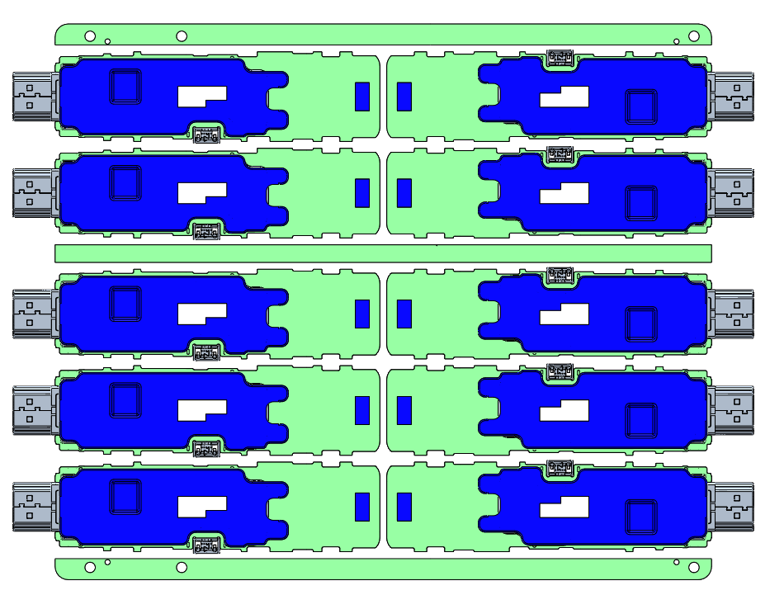
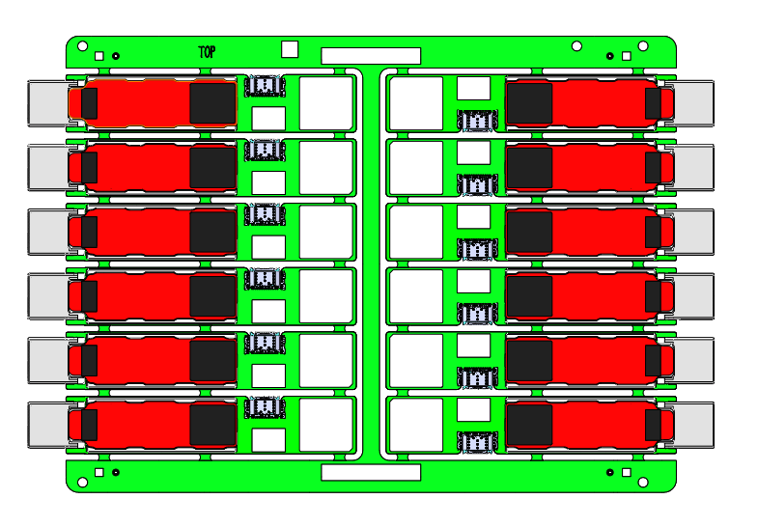
3.Product Change
unit：mm
PCBA：
Cony
Calla
Need to change the image from Calla newest panel design Drw, the W reduce from 184mm to 177 mm
137.6mm
159mm
187.8mm
184mm
6

Slide 8
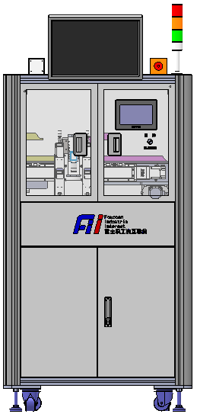
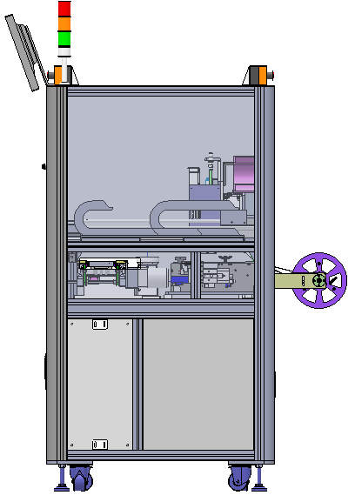
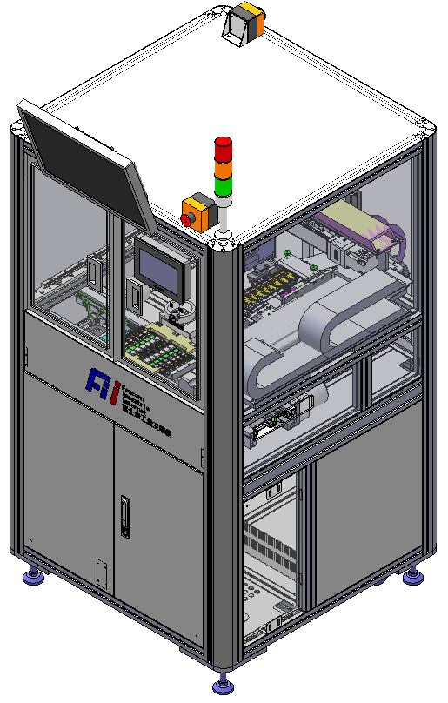
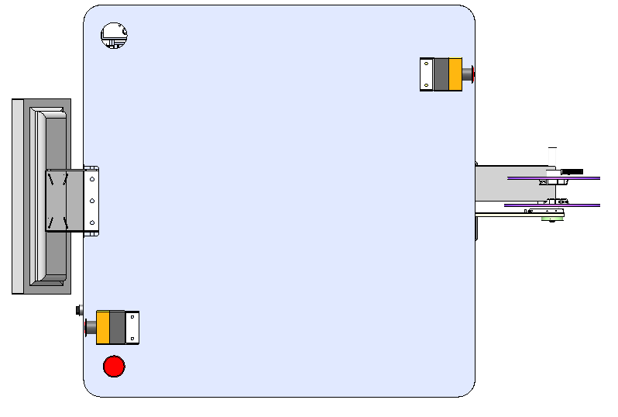
4. Machine layout
unit：mm
335mm
PC
Tricolor lamp
1630mm
Touch screen
500mm
 | automatic | manual
CT | 48.0S | /
UPH | 500PCS | /
165.5mm
287.5mm
7

Slide 9
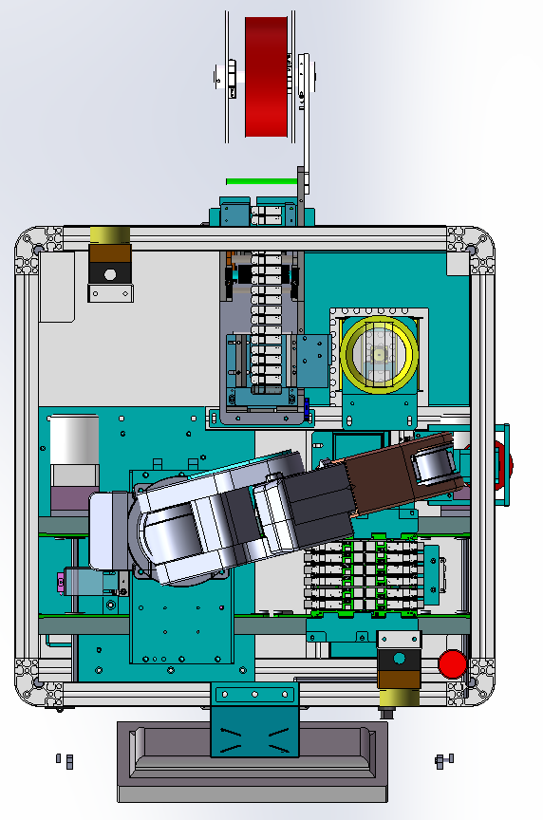
4. Machine layout
unit：mm
5
Bidding machine (feeding)
item | Process flow
1 | Conveyor line flow buffer
2 | Infeed conveyor line
3 | Position the component(Clamp the PCBA board)
4 | Robot
5 | Bidding machine (feeding)
6 | under CCD components(Label fills ）
7 | Upper CCD & Reclaiming Assembly(Product positioning ）
8 | Buffer after the flow of the conveyor line
4
Robot
6
under CCD components(Label fills ）
7
Upper CCD & Reclaiming Assembly(Product positioning ）
3
Position the component(Clamp the PCBA board)
8
Buffer after the flow of the conveyor line
2
Infeed conveyor line
1
Conveyor line flow buffer
8

Slide 10
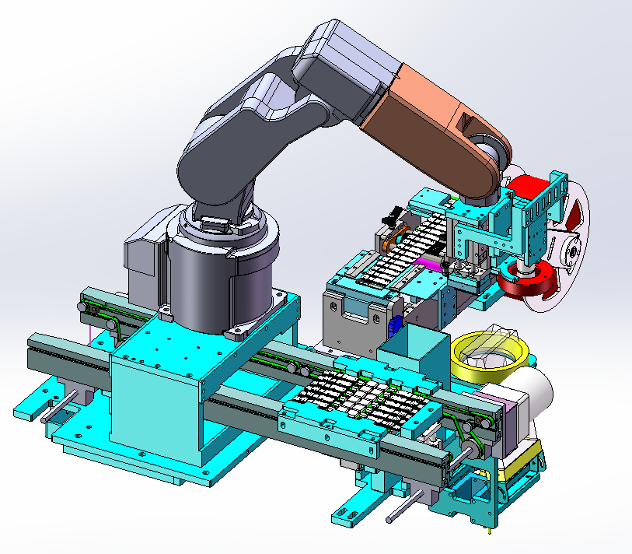
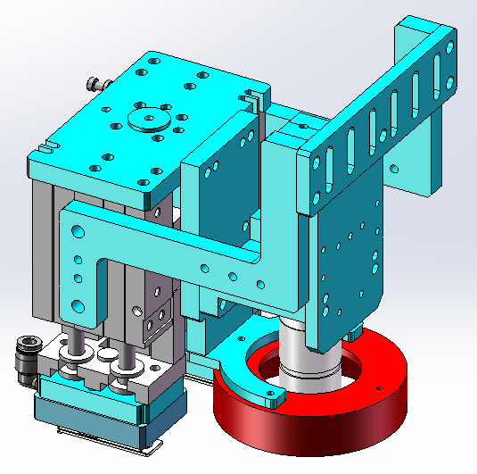
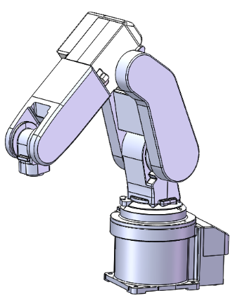
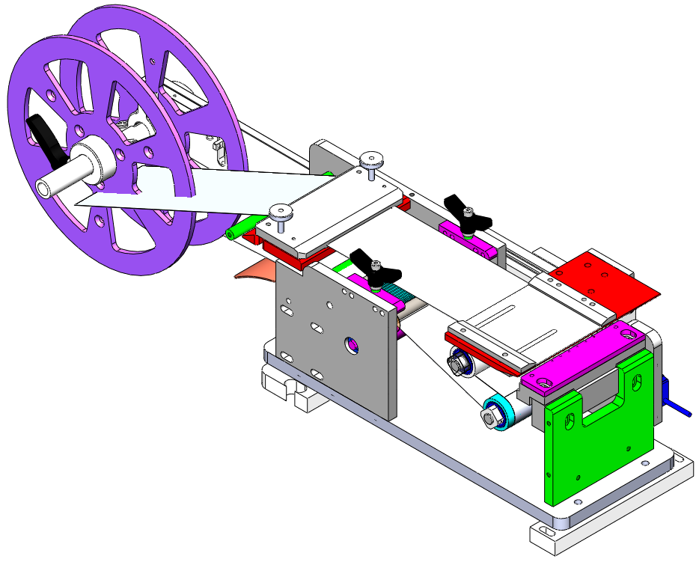
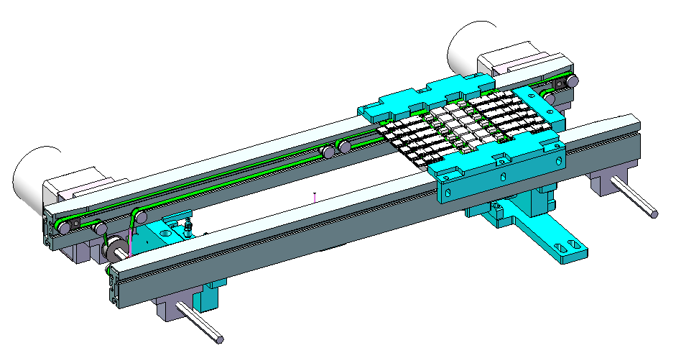
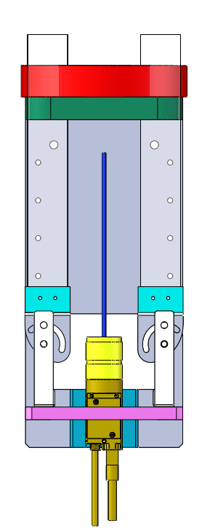
4. Machine layout
3
Upper CCD & Reclaiming Assembly
unit：mm
2
Robot
4
Bid dispenser
1
Infeed conveyor line
5
Under CCD
9

Slide 11
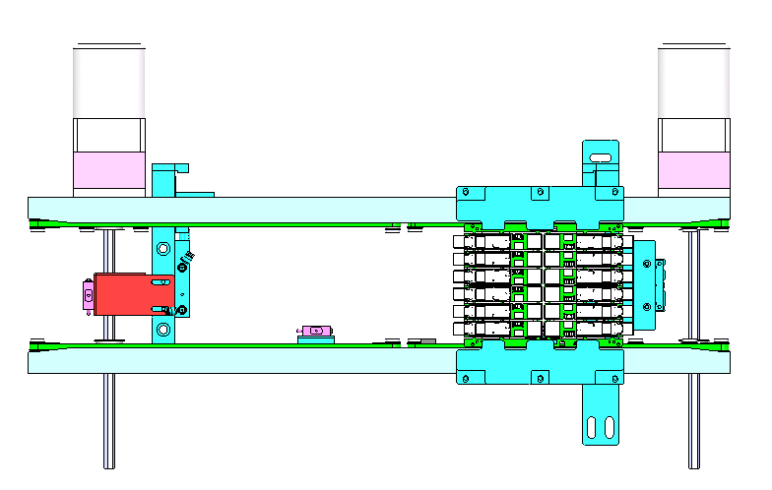
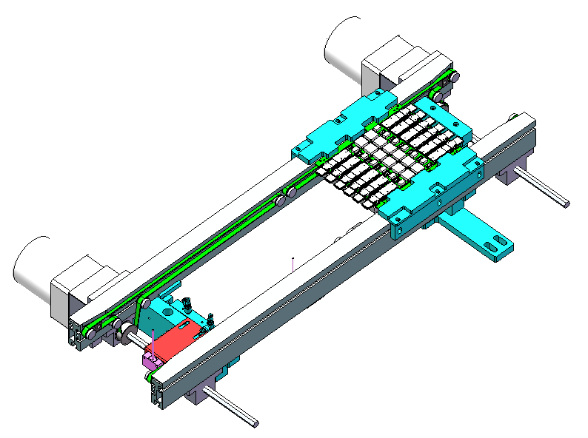
5. The key components
5.1 Feed conveyor line
Due to changes in the length
of the PCBA, need to
change the blocking block of
the blocking cylinder
PCBA blocking cylinder
PCBA in place deceleration sensor
Motor
138.6mm
PCBA lifting limit component
PCBA jacking cylinder
PCBA support board
Sensor CX-461A
Detect whether the PCBA drives into the conveyor line
Sensor CX-461A
Detect whether the PCBA drives into the conveyor line
PCBA board positioning process:
1.The PCBA board flows into the conveyor line, and the CX-461A senses that the conveyor line
slows down and blocks the PCBA board from the blocking cylinder.
2.The lifting cylinder is pushed out to position the PCBA board.
10

Slide 12
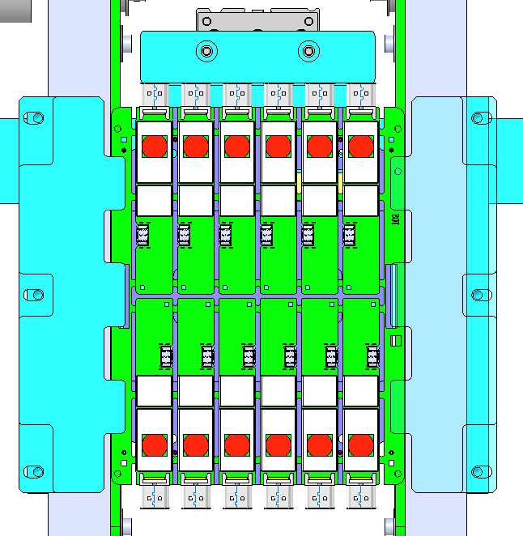
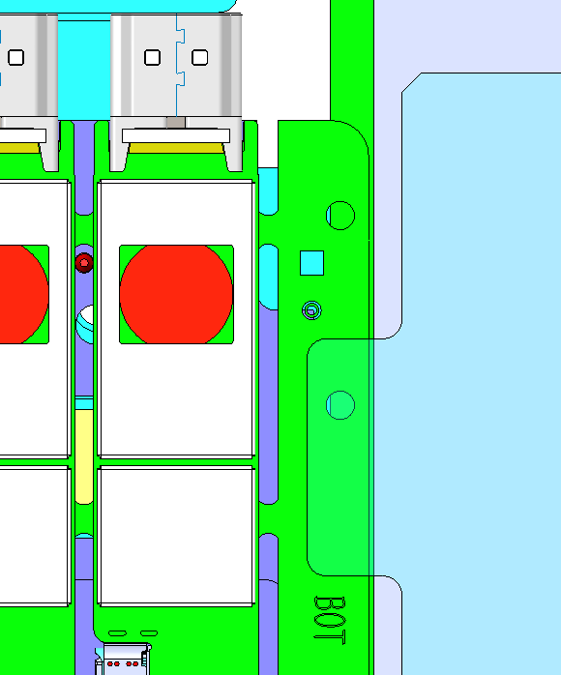
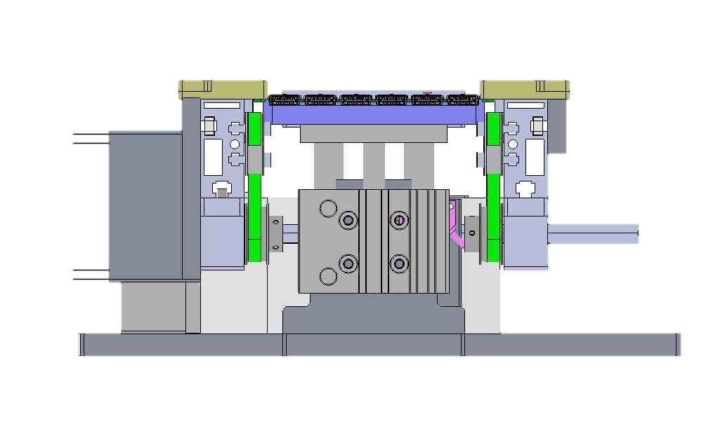
5. The key components
5.1 Feed conveyor line
unit：mm
The clamp block is in contact with the edge strip of the connecting plate 3.8mm
clamping position
The distance between the connecting plate and the edge of the conveyor line is 0.5mm
PCBA board clamping:
1. PCBA board arrives at the assembly position;
2, the block cylinder is blocked out3. At the same time, the support plate rises to support the PCBA board.
11

Slide 13
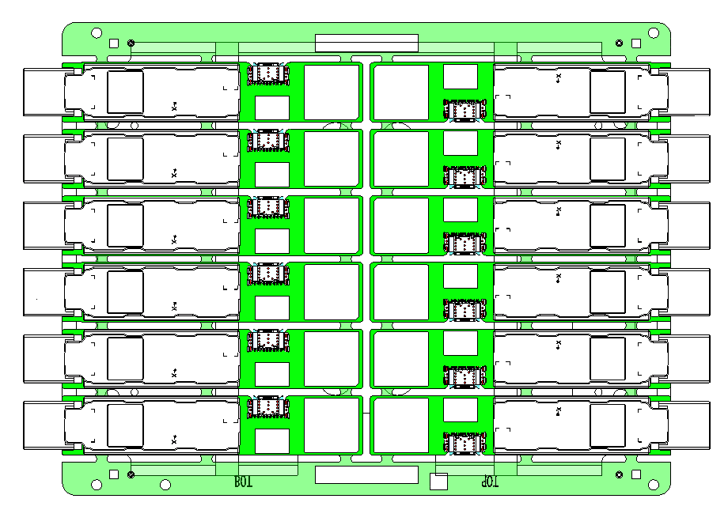
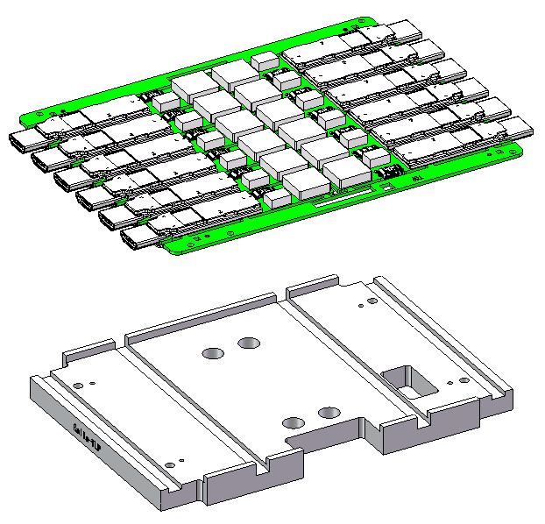
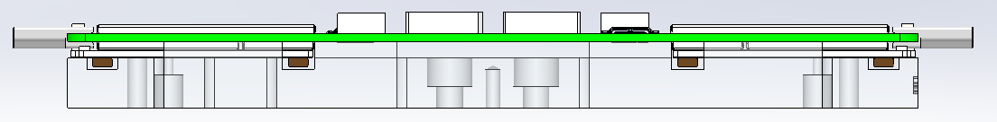
5. The key components
5.1 Feed conveyor line
unit：mm
1.1mm
40mm
1.3mm
The PCB foam on the
front end is 1.1mm
away from the edge
of the avoidance slot
The size of the
scanner avoidance
slot is 18x40mm
The PCB foam on the
rear end is 1.3mm
away from the edge
of the avoidance slot
T-side jacking plate(A6061)
12

Slide 14

5. The key components
5.2 Robot
unit：mm
1
Maximum lifting weight 最大可搬重量 | 3KG
Arm length 臂長 | 504mm
Positional repeatability 位置重複精度 | ±0.02mm
Accuracy of software algorithm 软件算法精度 | ±0.02
位置重複精度 =±0.02mm；
Positional repeatability =±0.02mm；
組裝精度=位置重複精度 +下蓋CCD识别精度+PCB CCD识别精度+软件算法精度：±（0.02+0.0025+0.0025+0.02）=0.045mm。
Assembly accuracy = Positional repeatability + front housing CCD identification accuracy + PCB CCD identification accuracy+softwarealgorithmaccuracy:±(0.02+0.0025+0.0025+0.02) =0.045mm。
RV-2FR
13

Slide 15
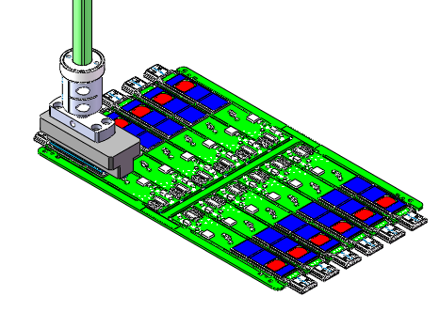
5. The key components
5.3 Material Fetching Component
unit：mm
1
Upper CCD
light source
Nozzle
14

Slide 16
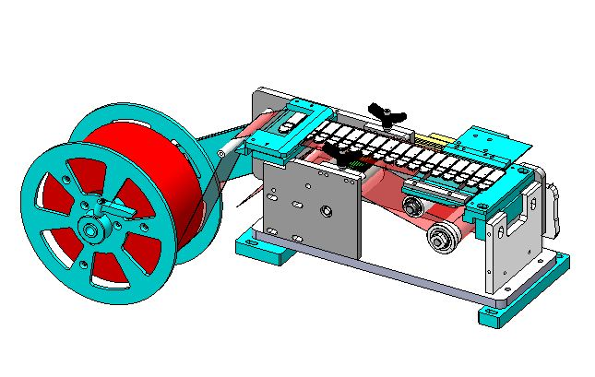
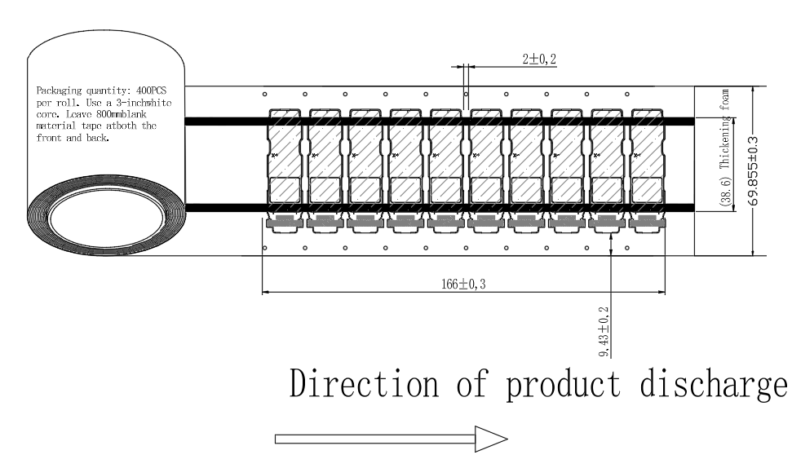
5. The key components
5.4 Feeder
2
Bid dispenser
category | 120-Forward push type bid dispensing machine (standard machine）
UPH | 1s/pcs
The maximum diameter of the coil | 76mm
Maximum strip width | 69.855mm
The quantity of a single roll of material | estimate500
unit：mm
Schematic of coil material
Material-sensing optical fibers
Reclaiming area
Note: It is recommended to manually wipe and clean the bidding platform with a dust-free cloth once per shift.
15

Slide 17
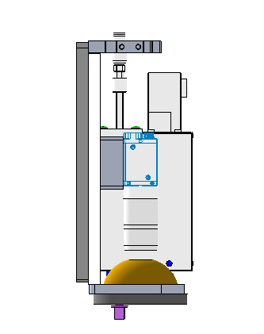
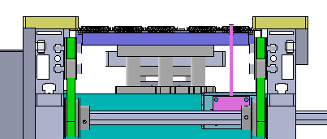
5. The key components
5.5 Upper CCD
1
unit：mm
Hardware name | Model | quantity
camera | FM-GE500-22M | 1
lens | RICOH/FL-CC2514-2M | 1
Lap pick-up | not | 0
light source | Light source/Hua Zhou/LRS-90W60 | 1
Light source controller | DKZ2-24V-2-AC | 1
layout：
camera：FM-GE500-22M
camera lens：FL-CC1214A-2M
Camera mounting orientation | Turn your back to the man-machine↑
The distance between the camera surface → the product | 350±10 mm
The light source → the camera surface | 50±10mm
visual field | 72mm*54mm
Image pixel size | 2592*1944
Camera single-pixel accuracy | 0.028
optical source：DRL-80W
50±10mm
350±10mm
PCBA

Slide 18
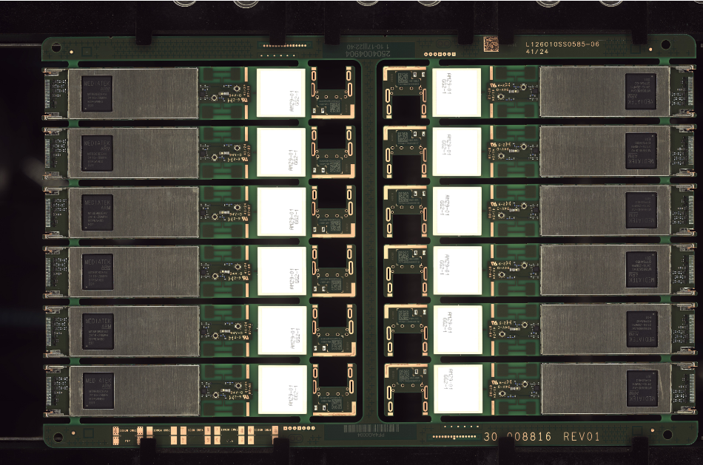
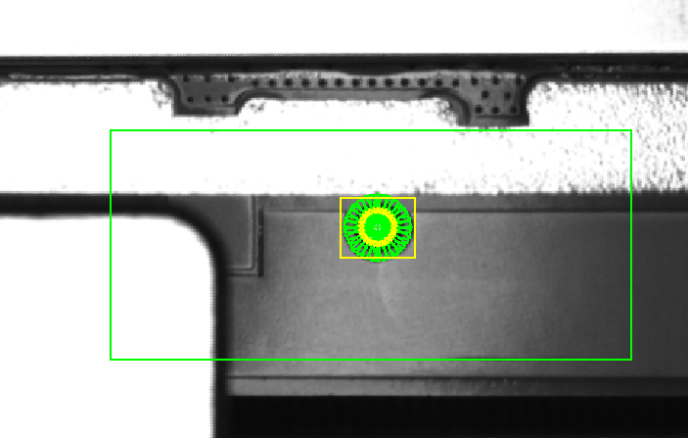
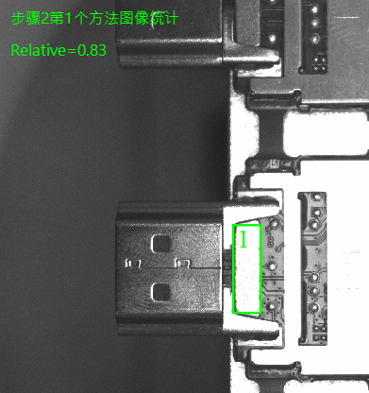

5. The key components
5.5 Upper CCD
2
1.Take Mark1 and Mark2 to calculate the Mark center of the camera to find the position.
The image processing method is NCC Pattern + Fit Circle
UpCCD image processing:
1.UpCCDMark Photo Location
2.Check for putting EMI
3.Check for putting Heat sinks
Need to change the image from Calla newest panel design Drw, the W reduce from 184mm to 177 mm
CCDUPMark2
Mark image processing
CCDUPMark1
Bot Side
2.Check：Whether there is EMI & Heat sinks
The image processing method is Image Statistic / YoloV5 Object Detection

Slide 19
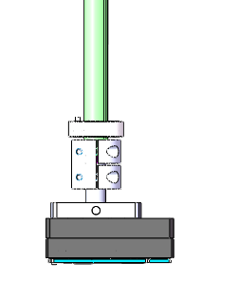
5. The key components
5.5 Lower CCD
unit：mm
3
Hardware name | Model | quantity
camera | FM-GE500-22M | 1
lens | RICOH/FL-CC2514-2M | 1
Lap pick-up | not | 0
light source | Light source/Hua Zhou/LRS-132W30 | 1
 | Light source/Hua Zhou/BAR-108W30 | 2
Light source controller | DKZ2-24V-2-AC | 1
layout：
material
Heat sinks
optical source：LRS-132W30
215±10mm
Camera mounting orientation | Turn your back to the man-machine↓
The distance between the camera surface → the product | 350±10 mm
The light source → the camera surface | 40±10mm
The camera surface → a ring-light source | 215±10mm
visual field | 72mm*54mm
Image pixel size | 2592*1944
Camera single-pixel accuracy | 0.028
350±10mm
optical source： BAR-108W30
40±10mm
camera lens：FL-CC3516-2M
camera：FM-GE500-22M

Slide 20
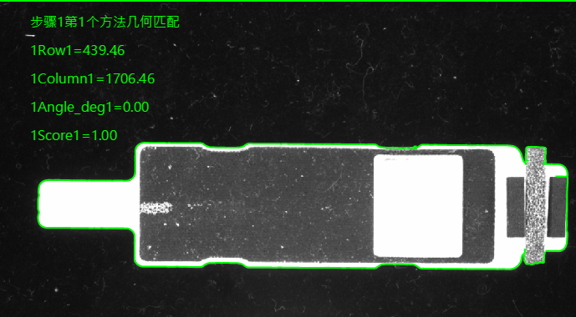
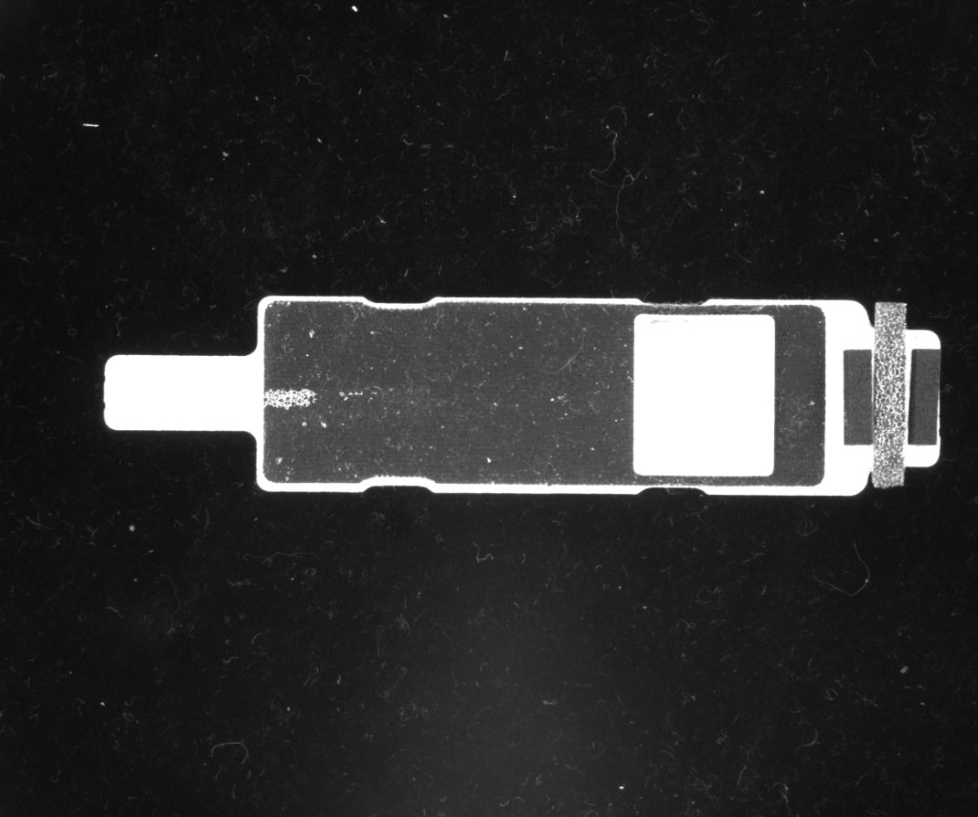
5. The key components
5.5 Lower CCD
4
DnCCD image processing:
1.DnCCDMark Photo Location
Need to change the Heatsink image of Calla instead of Cony
Take Mark1 to calculate the Mark center of the camera and the angle to find the position.
The image processing method is Shape Pattern

Slide 21
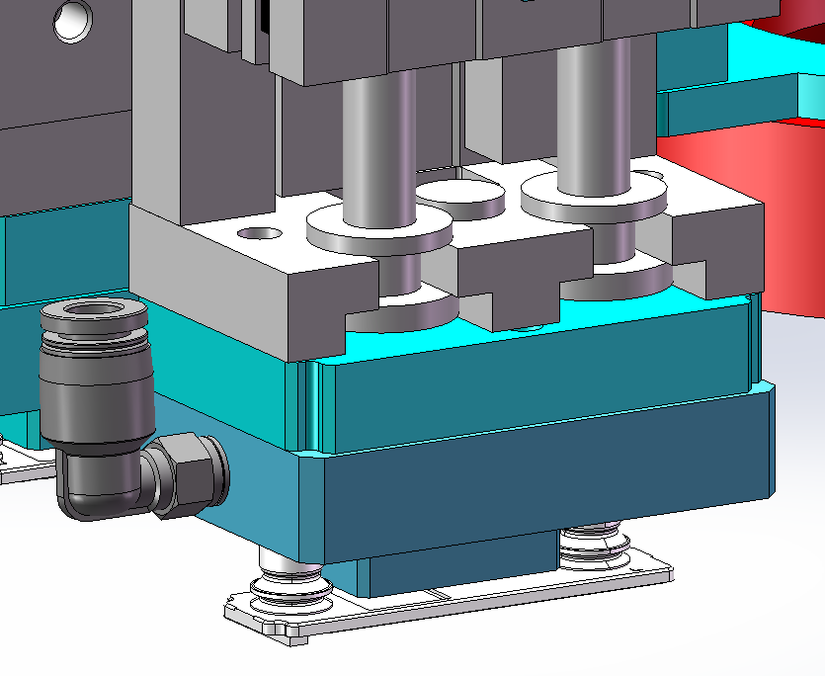
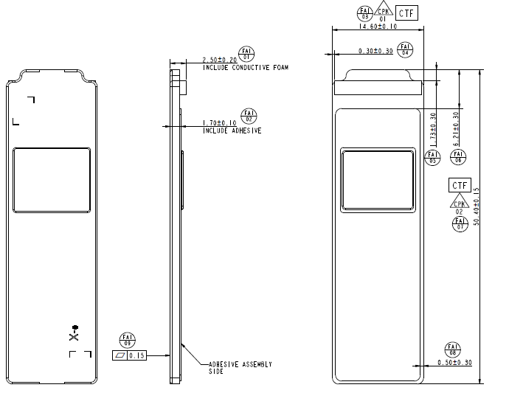
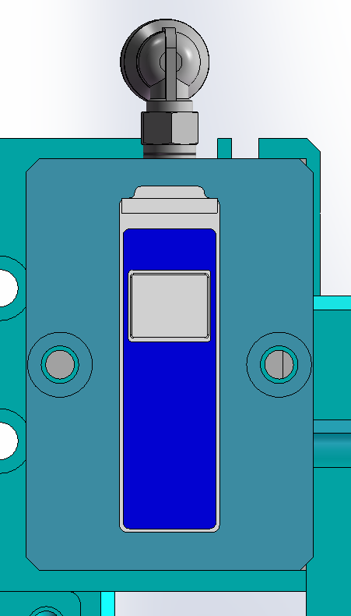
6. The key components
6.1 Feed suction nozzle
unit：mm
1
The adsorption surface is customized according to the shape of each excipient
20

Slide 22
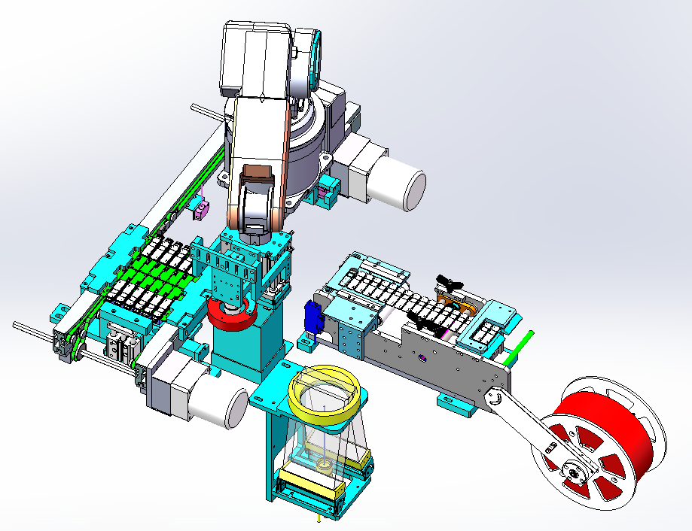
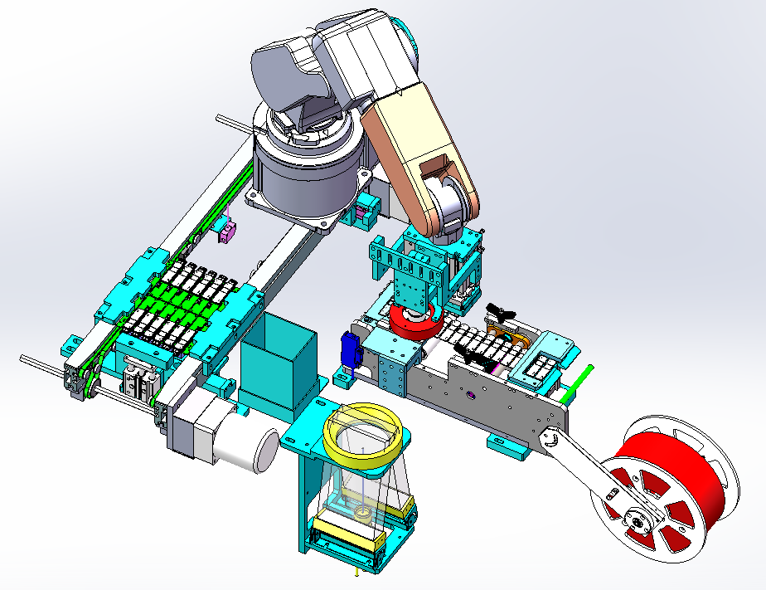
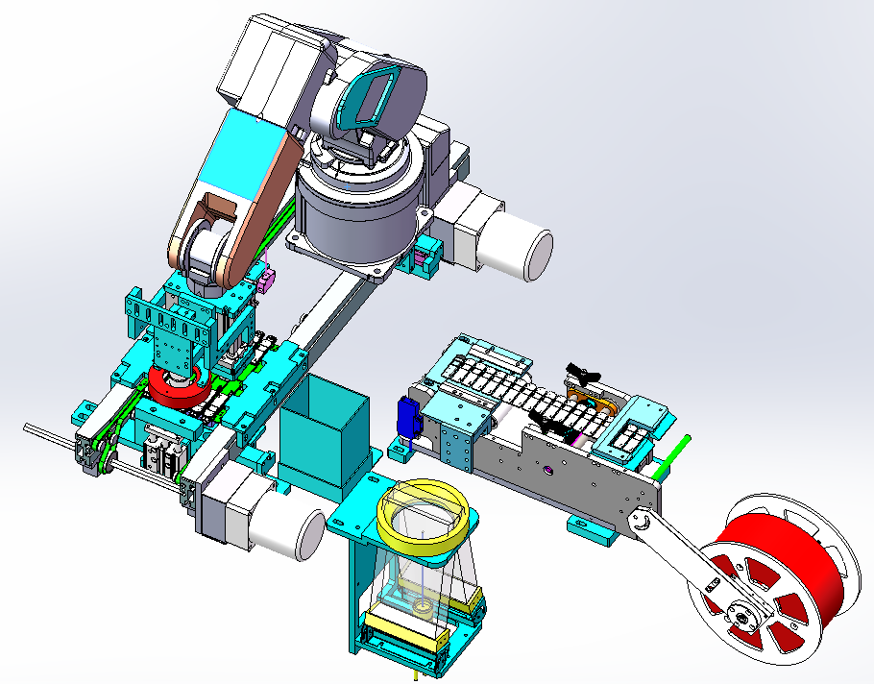
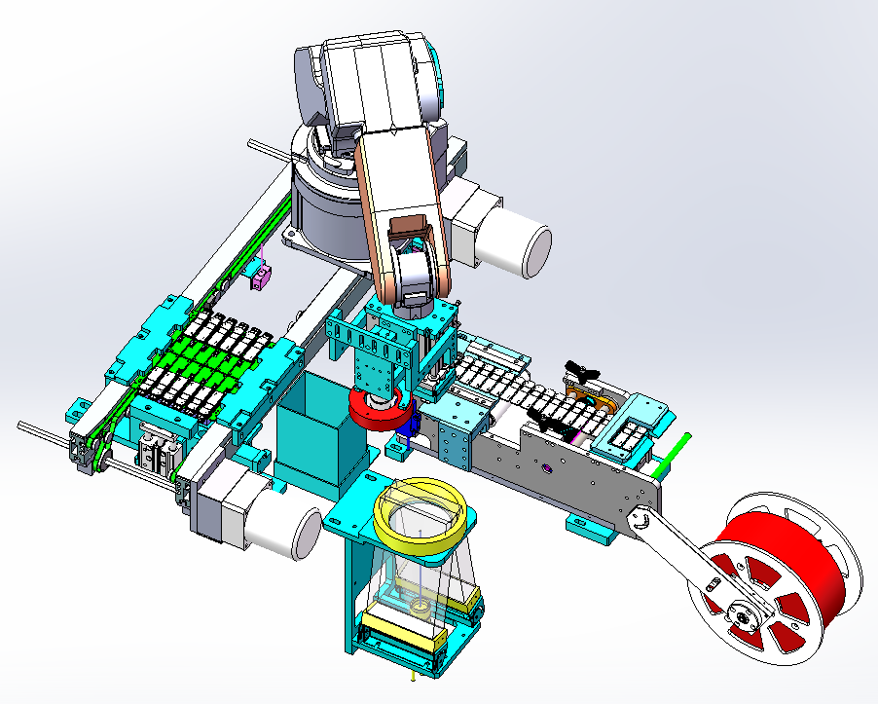
7. Action flow design
unit：mm
Step1: The PCBA board of the front transmission line flows in, blocking the cylinder from rising, the sensor in place responds, and the top cylinder rises, and the PCBA link is clamped to block the cylinder from descending
Step2: The CCD identifies and locates the Mark point of the PCBA
Step3: The placement head moves to the reclaiming area to pick up the loose heat sheets
Step5: The jacking cylinder descends, and the conveyor line at the back section of the PCBA board enters the next process
Step4: The placement head is moved to the lower CCD to identify EMI
Step5: The placement head is moved to the placement area for placement
21

Slide 23
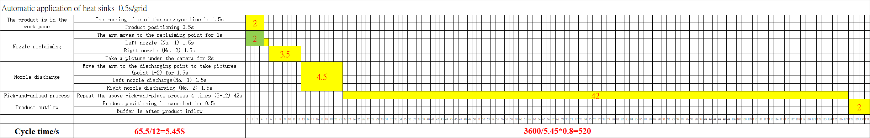
8. Timing diagram
unit：mm
UPH≈3600/(65.5/12)*0.8 ≈520
Note：80% is estimated OEE, only for UPH calculation. not real product data
22

Slide 24
Thank you
23

